Slide 1
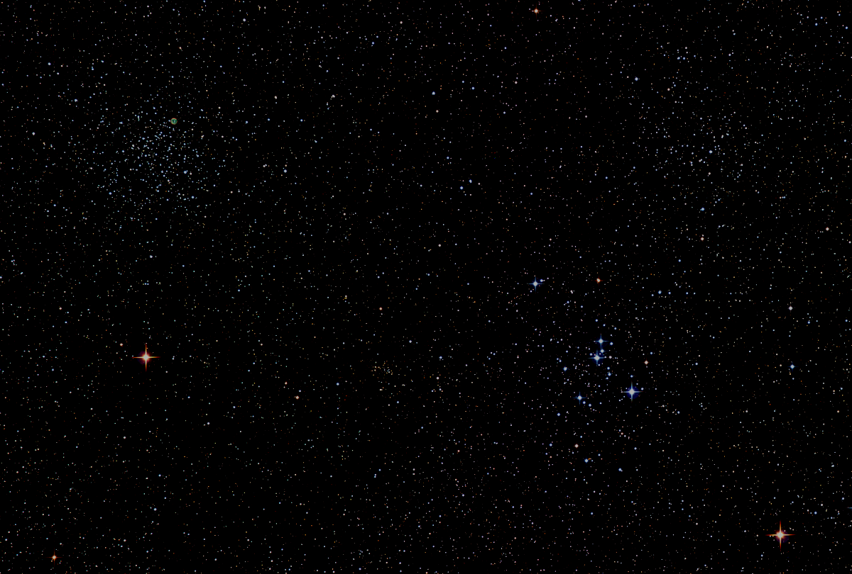

Howard
Astronomical
League
17
November 16th, 2017
Notes:
Howard Astronomical League, Oct 19, 2017

Slide 2
Introductions

Slide 3
Thank You!
Joel Goodman
and
Bob Savoy
Public outreach support to the
Annapolis Naval Sailing Association

Slide 4
Upcoming Events
HAL Events – Alpha Ridge Park
Nov 18th at 5:00pm – Public Star Party
Dec 2nd at 4:30pm – Public Star Party

Slide 5
2018 HAL Elections
Election Committee Chair: Joel Goodman
Elections held at the January 18th general meeting to elect the 2018 Board of Directors
Send nominations to election@howardastro.org by 7pm on January 17th, 2018
New term begins Feb 1st, 2018

Slide 6
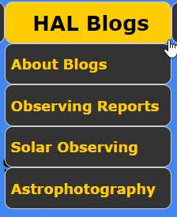
The HAL Board has established three new committees/blogs this year:
Bob Prokop
Phil Whitebloom
Ken Everhart

Slide 7
This Evening’s Speaker
Ernie Wright
NASA/GSFC, Sciences and Exploration Directorate
HAL Member
Lunar Reconnaissance Orbiter Science Results
Notes:
It is my distinct pleasure to introduce Dr. Bindu Rani. She has been a Postdoctoral Fellow at NASA/Goddard Space Flight Center since July 2016, and will continue to hold that post until June 2019. She was also a Postdoctoral Fellow at the Max-Planck-Institut für Radioastronomie Bonn, Germany from February 2014 to June 2016. She has held visiting scientist and researcher positions at the Korean Very Long Baseline Interferometry Network of the Korea Astronomy and Space Science Institute, and The Gra-dig-nan Bordeaux Nuclear Research Center in France. Dr. Rani has experience in Gamma-ray, X-ray, optical, and radio astronomy. Her optical observational experience includes use of the 1.04 meter telescope at AIRES, Na-in-i-tal, India, and the 1.20 meter telescope at Mount Abu, India.
Among her many achievements, Dr. Rani was awarded the Otto Hahn Medal for outstanding scientific achievements by the Max Planck Society in 2015. She holds Bachelor and Master of Science degrees from University of Delhi and Da-yan-and University, respectively, in India. Last, and certainly not least, Dr. Rani completed her Ph.D at Max-Planck-Institut für Radioastronomie and University of Köln, both in Germany in 2013.

Slide 8
Member’s astrophotos
and sketches

Slide 9
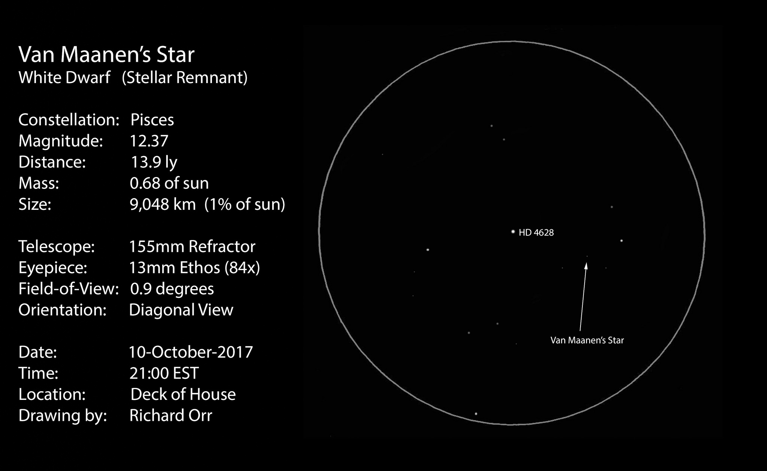

Slide 10
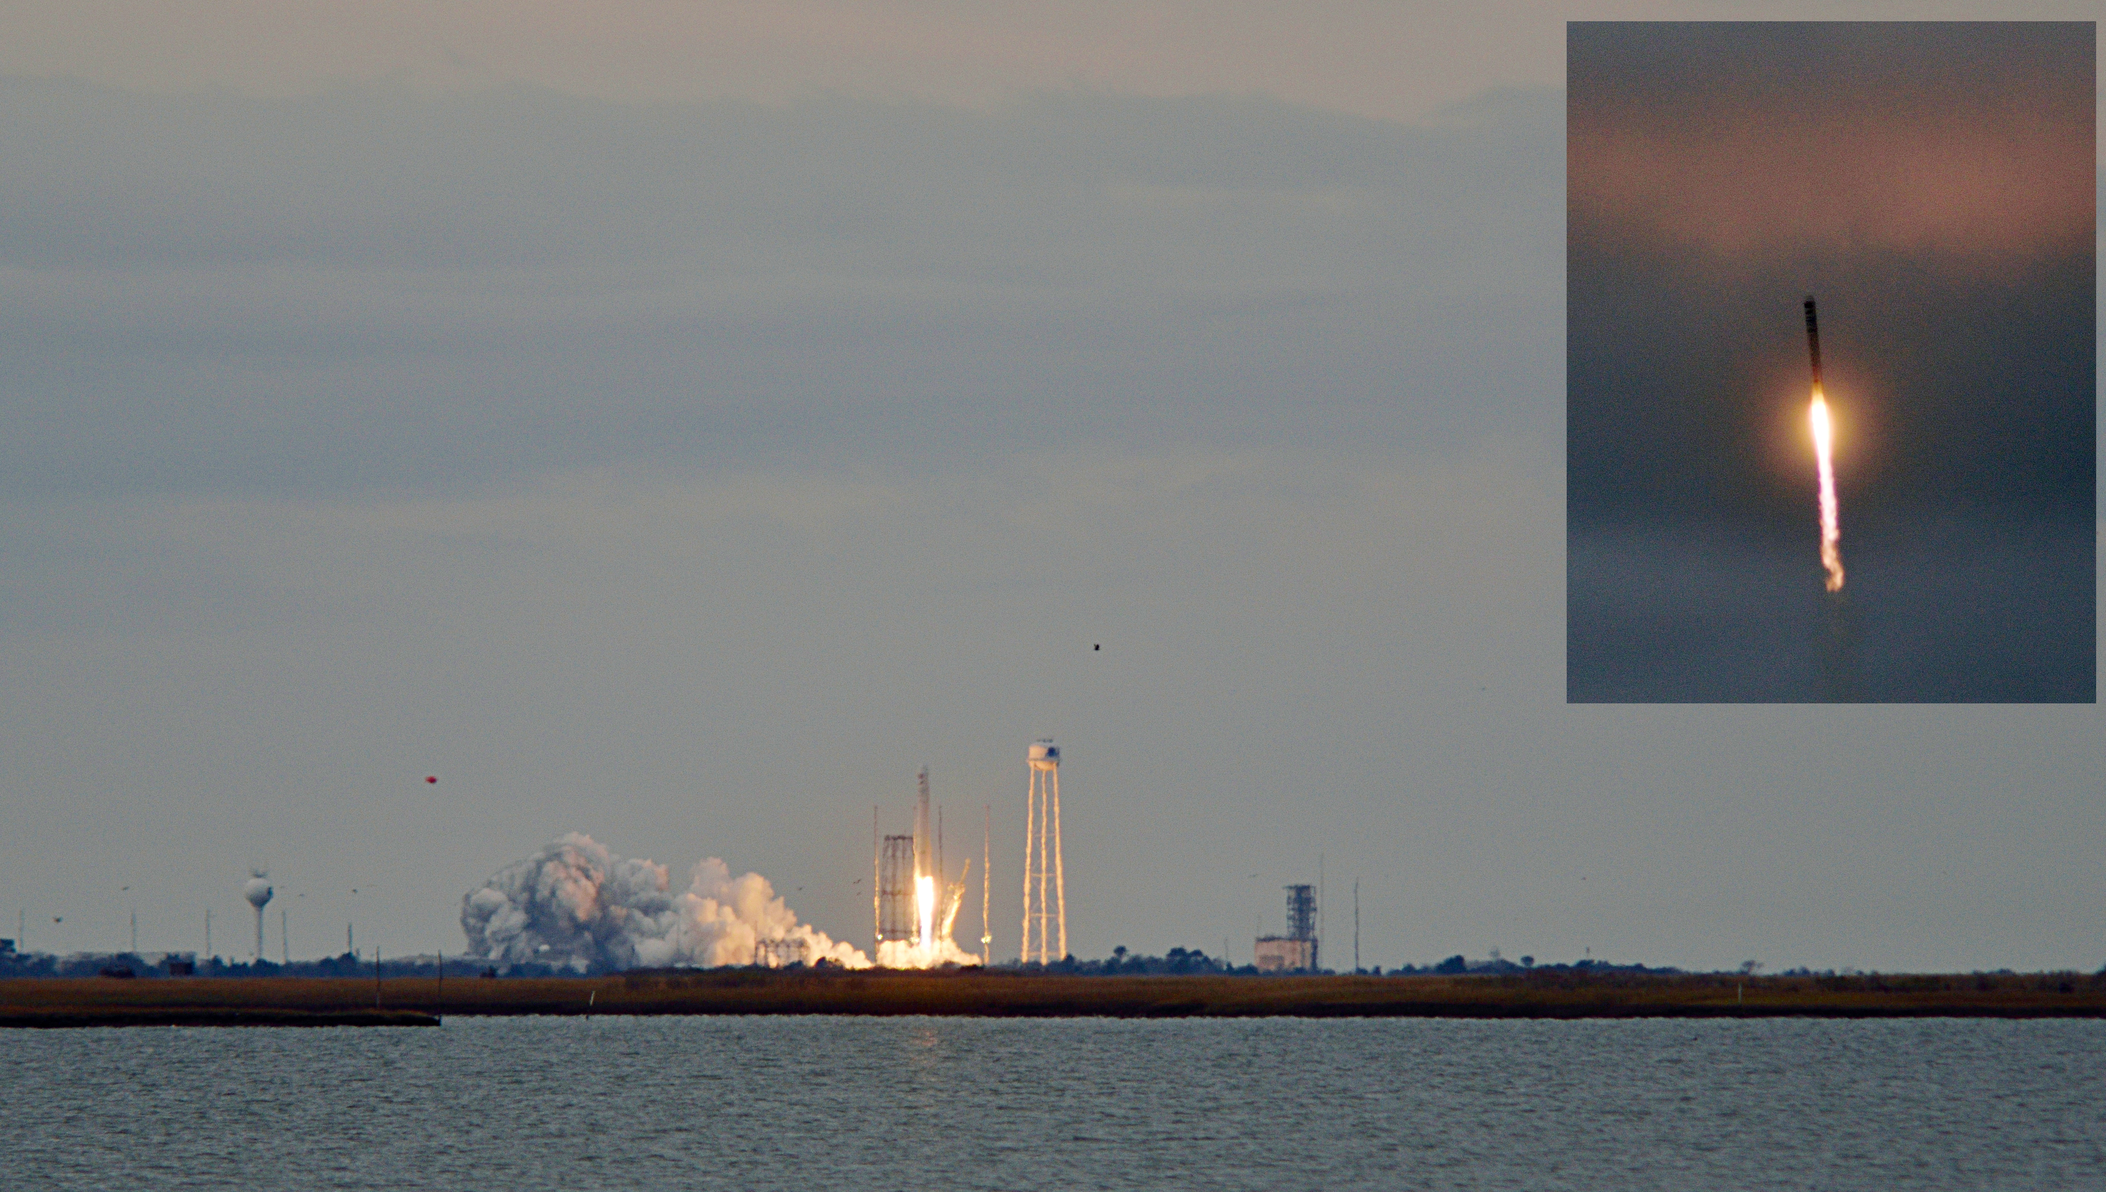
Gene Handler
Antares/ISS Resupply Launch from Wallops Island

Slide 11
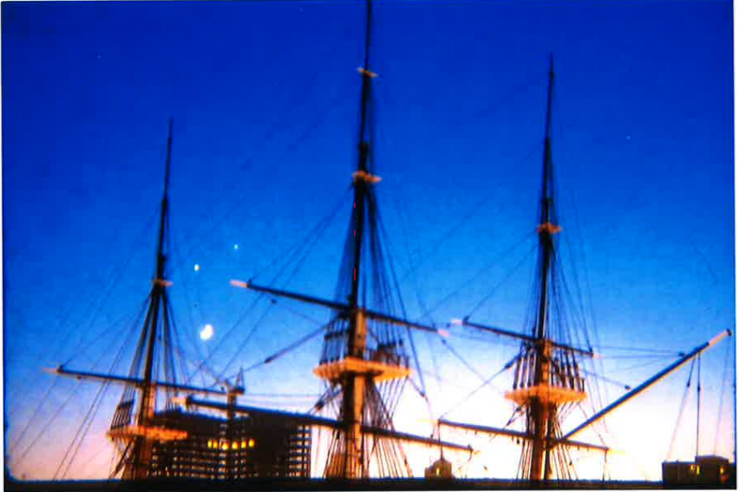
Moon, Venus and Jupiter over USS Constellation in Baltimore Harbor
HAL Legend Herman Heyn, November 25, 2184

Slide 12
Thank You!
Next month’s meeting is on Thursday, December 21st, 2017 at 7 PM
HAL Potluck
HAL President’s Year-end Wrap Up

